Slide 1
Quality and Cost
in the
True Performance Program
Capstone Project 2019 – Highmark Inc
Moe Wolf (MSHCPM ‘20)
Jonathan Dyer (MISM ‘19)
Jeremiah Humes (MSHCA ‘20)
Manjiri Kshirsagar (MSHCPM ‘20)
Faculty Advisor: James F. Jordan

Slide 2
Agenda
Problem Statement
Framework for Evaluation
Analysis
Recommendations

Slide 3



Objective
Which of the quality metrics are driving the cost outcomes?
What other quality metrics could potentially be removed?
Investigate the state of value-based reimbursement programs.
Notes:
Explain VBR program

Slide 4
Takeaways
VBR is early in the Continuous Improvement Cycle
More closely aligned measurement
Majority of progress has been made in cost measurement
Complexity of the program inhibits physician engagement
Missing a consistent, repeatable evaluation method

Slide 5


Program Evaluation Framework
What is it?
Industry standard method for assessment
Systematic approach to improve or affirm success of a program
Why did we choose it?
Eliminate the issue of confirmation bias
Investigate areas where a program can be improved
Notes:
Also helps explore reasons for certain features not working

Slide 6
Program Evaluation Framework
Needs Assessment
Program Theory
Process Evaluation
Outcome Evaluation
Nature, magnitude and extent of the problem
Program conceptualization and design
Program operations, implementation, service delivery
Impact on targeted outcomes
Notes:
Detailed framework and further readings included in appendix
This framework can be used in future evaluations of TPP
This is how we will be presenting today, given in the handout

Slide 7
Constraints and Limitations
Lack of comprehensive time series data
Time duration of evaluation
Lack of Provider level data who did not participate in program
Limited access to participating providers

Slide 8
Determining the Nature of the Problem
Needs Assessment
Program Theory
Process Evaluation
Outcome Evaluation
What is the problem that the program is trying to address?
What is the extent of the problem?
Who is the target population?
Notes:
Target population is doctors. Ultimate client/ population are patients.

Slide 9
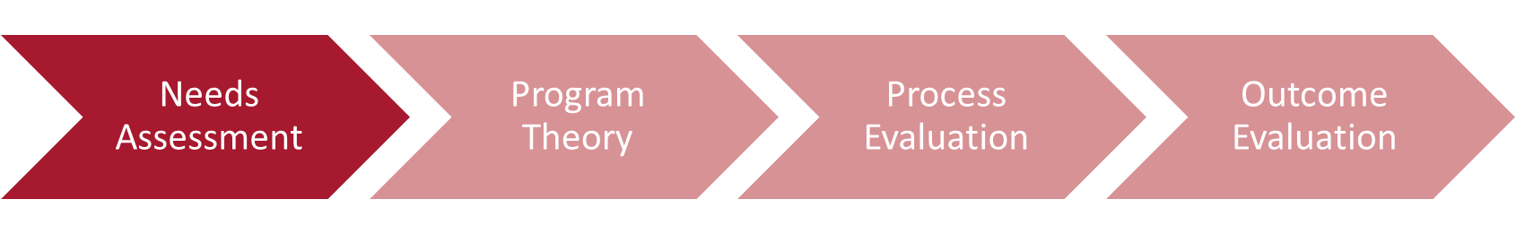
Problem Addressed
Over utilization of services
Reactive care delivery
Misaligned incentives
Fee for Service in
Primary Care
May not achieve desired outcomes
No fees for high valued services
Cannot ensure high quality services
Notes:
Miller, H. (2017)
Fee-for-service payment does not assure that the
services a patient receives are appropriate, high
quality, or achieve the results the patient needs;
Fee-for-service payment rates are often less than the
cost providers incur in delivering high-quality,
appropriate care;
There are no fees at all for many important, high-value
services; and
It is impossible for patients or payers to predict the
total cost of treating a health problem and to compare
the costs across providers.
These problems are inter-related in ways that make it
difficult or impossible to solve one without also solving
the others. A key reason that most value-based payment
and purchasing initiatives have produced disappointing
results is that they have tried to solve only a subset of
these problems without addressing the others.
United Healthcare Report - https://www.uhc.com/content/dam/uhcdotcom/en/ValueBasedCare/PDFs/VBC-Nov2016-Online-Report.pdf

Slide 10
Defining the Blueprint of the Program
Needs Assessment
Program Theory
Process Evaluation
Outcome Evaluation
Understanding the program and its components
Intended Effect of Program
Environmental scan
Notes:
There is a difference between implementation and theory
There could be a breakdown in logic at either point, which would then show where the problem would be that needs to be addressed

Slide 11


True Performance Objectives
Supporting Primary Care Physicians (PCPs) in coordinating care, managing chronic illness, and providing preventive care.
Improve Experience of Care
Improving Health of Population
Reducing Per Capita Cost of Healthcare
Based on IHI’s (Institute of Healthcare Improvement)
“Triple Aim” of healthcare improvement

Slide 12
Program Hierarchy
Reimbursement Opportunities
Reimbursement Type
Care Coordination
Lump Sum
Additional Incentives
Performance Measurement
Quality
Referral Management
Strong Medicare STARS ratings
Quality
Cost & Utilization
Indicators
Total Cost PMPM
ED Utilization
STARS Ratings
QA Score

Slide 13
Program Hierarchy
Reimbursement Opportunities
Reimbursement Type
Care Coordination
Lump Sum
Additional Incentives
Performance Measurement
Quality
Referral Management
Strong Medicare STARS ratings
Quality
Cost & Utilization
Indicators
Total Cost PMPM
ED Utilization
STARS Ratings
QA Score

Slide 14
Stakeholder Perspective
Regulatory
Highmark Insurance
Primary Care Physicians
Patients
Aligns with Medicare Plan
STARS Ratings
Reduces healthcare costs
Incentivizes focus on prevention and wellness
Better health outcomes especially for chronic illness patients
Reduces preventable Emergency Department visits
Allows PCPs to improve their processes and implement best practices
Improves patient experience
Reduces readmissions and inpatient stays

Slide 15
Quality Component Logic Model
Inputs
Outputs
Outcomes
Short term
Long term
Risk Adjusted Quality Score
Emergency Department Visits
Per Member Per Month Cost
Quality Metrics
Financial Incentives
Rate
Patient Experience
Health Outcomes
Risk
Readmissions

Slide 16
Quality Metrics Overview
No. of Quality Metrics
CMS Meaningful Measurement Area
2
2
15
Substance Use
Readmission to Hospitals
Management of Chronic Conditions
4
18
1
Appropriate Use of Healthcare
Preventive Care
Preventable Healthcare Harm
Notes:
Full CMS “Meaningful Measures” data in appendix identifies highest priorities for quality improvement and measurement

Slide 17
Environmental Scan
The strength of evidence on the effectiveness VBR improving health delivery and patient outcomes is mixed and modest.
Many studies were over a short time frame.
Longer study period may allow better observation of long-term outcomes.
There are mixed results regarding the success of pay for performance programs; most programs show no association with lower cost outcomes and better health outcomes
Notes:
References:
Eijkenaar, Frank, Martin Emmert, Manfred Scheppach, and Oliver Schöffski. "Effects of pay for performance in health care: a systematic review of systematic reviews." Health policy 110, no. 2-3 (2013): 115-130.
Damberg CL, Sorbero ME, Lovejoy SL, et al. Measuring Success in Health Care Value-Based Purchasing Programs: Findings from an Environmental Scan, Literature Review, and Expert Panel Discussions. Rand Health Q 2014;4:9

Slide 18
Program Implementation
Needs Assessment
Program Theory
Process Evaluation
Outcome Evaluation
Reach
Recipient Perspective of Program
Implementation Fidelity – Dose Delivered and Received

Slide 19
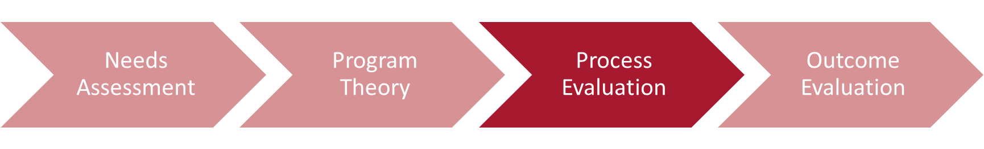




Reach & User Perspective
Doctors and patients in the program
Physician satisfaction*
Extent of engagement with the program
Quality Metrics Details
Providers in program: 548
Patients in program: 1.16 million
“An unreasonable number of reasonable requirements”
Many metrics = many interactions
Large administrative burden
Some metrics seem to express co-linearity
There are some “buckets” that don’t seem to have any metrics - outcome measures, health measures
Notes:
* Low sample size

Slide 20
Aligning Theory and Design
Effectiveness of Feedback
Collect qualitative data through surveys
Process Changes
Evaluate if there is a change in behavior or processes
Patient Experience
Survey patients
Population health management
Collect healthcare quality outcomes directly

Slide 21
Program Impact on Outcomes
Needs Assessment
Program Theory
Process Evaluation
Outcome Evaluation
Did the program have the intended impact?
What were the key metrics that caused the observed effect?

Slide 22

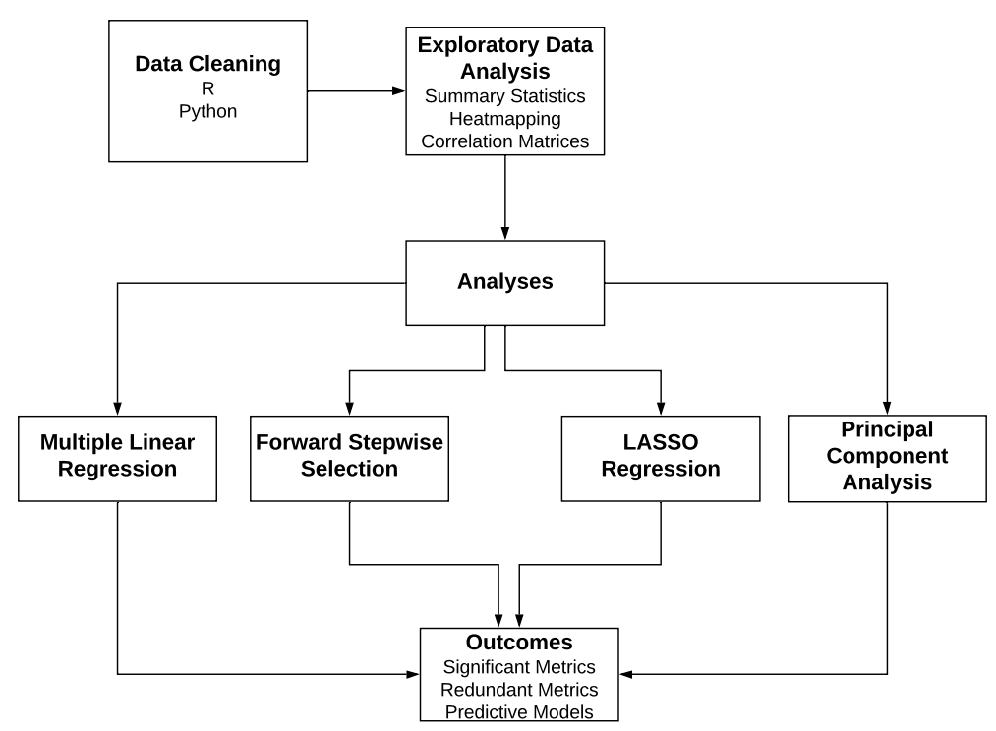
Quantitative Methods

Slide 23
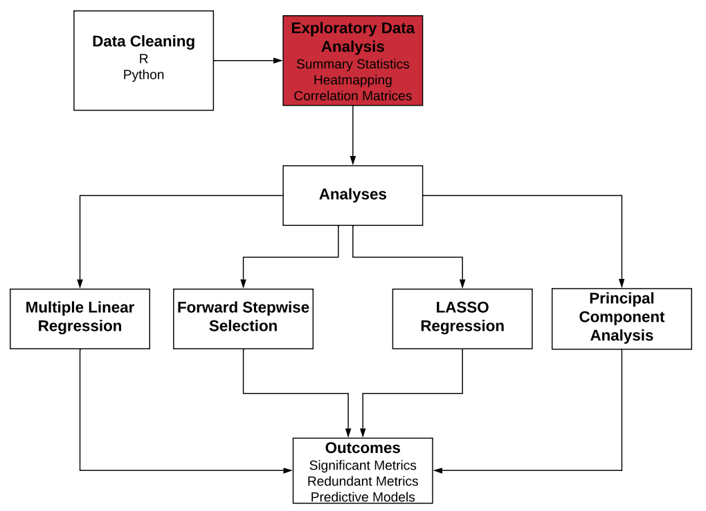
Quantitative Methods

Slide 24
Dataset Overview
38,000+ rows
Over 500 healthcare providers across 5 regions
~40 quality metrics per provider
1 year, one data point per provider per population
3 outcomes of interest:
PMPM – Per member per month cost of care
ED – Emergency department utilization
RDM – Readmission rates
3 populations: Pediatric, Adult, Senior
Notes:
We will be discussing Adult specifically, but other populations were similar

Slide 25
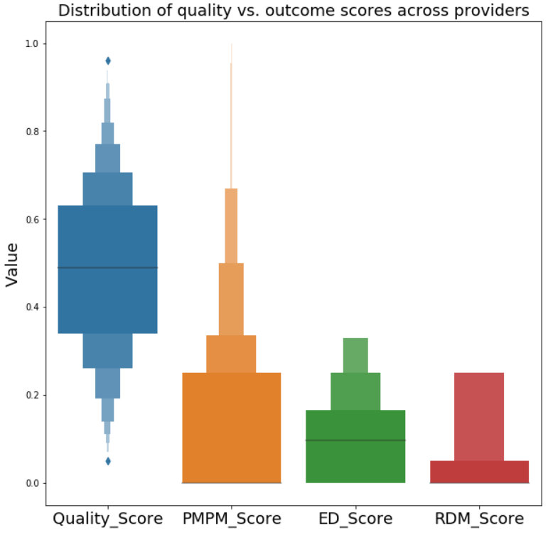
Quality and Outcomes
Distribution of quality vs outcome across providers

Slide 26
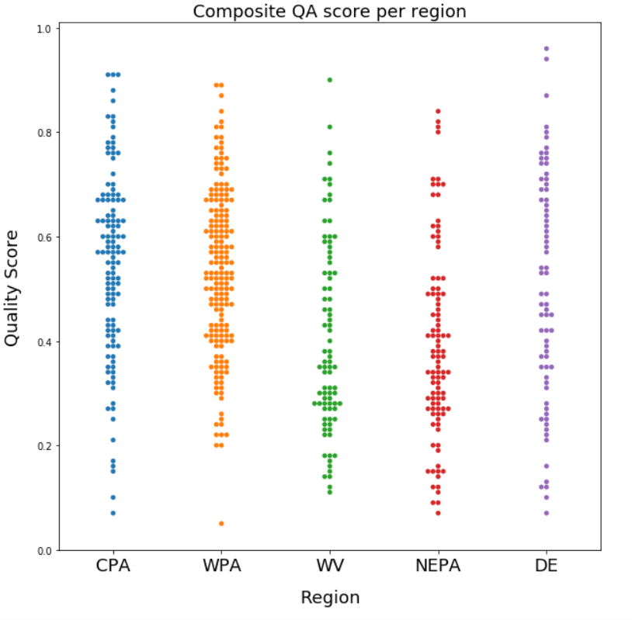
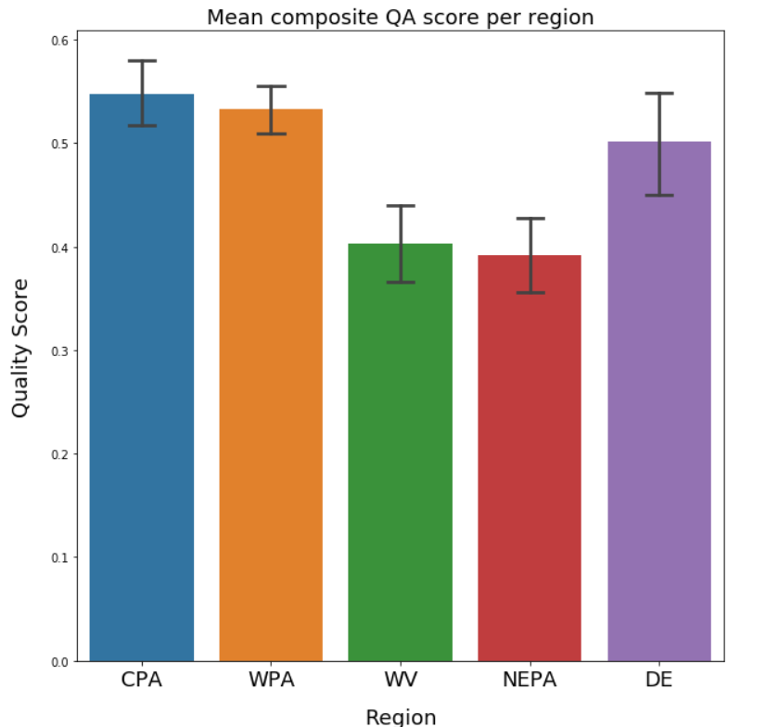
WV and NEPA have Lower QA Scores
Notes:
In general, kind of, the region does not seem to be affecting the scores

Slide 27
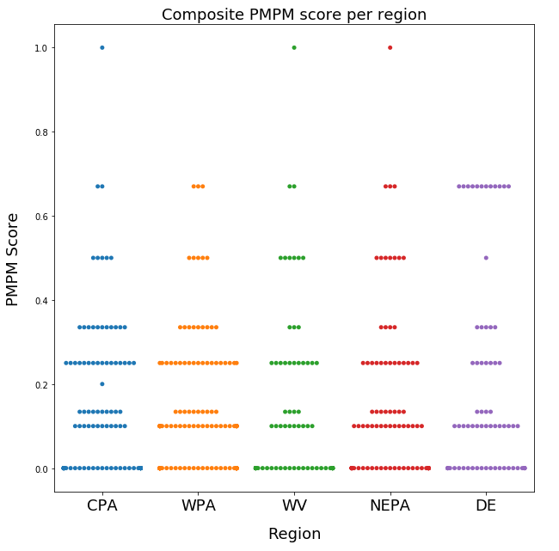
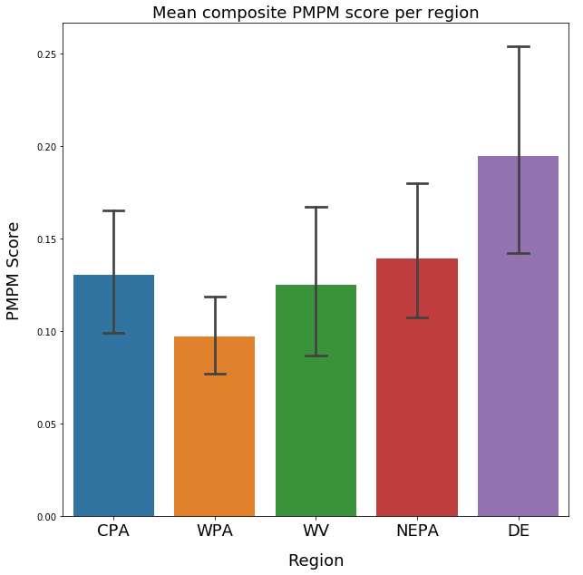
High Variance in PMPM Score
Notes:
This may or may not be significant

Slide 28
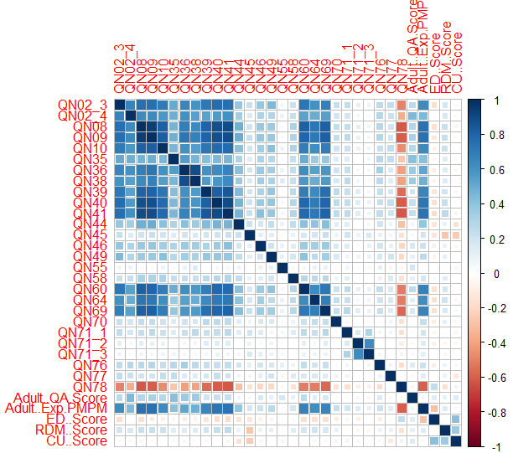
High Collinearities between Metrics
Most metrics were found to be highly correlated with each other
Outcomes did not show this correlation
This could lead to skewed results in a standard regression test
Lasso regression and PCA can account for this problem

Slide 29
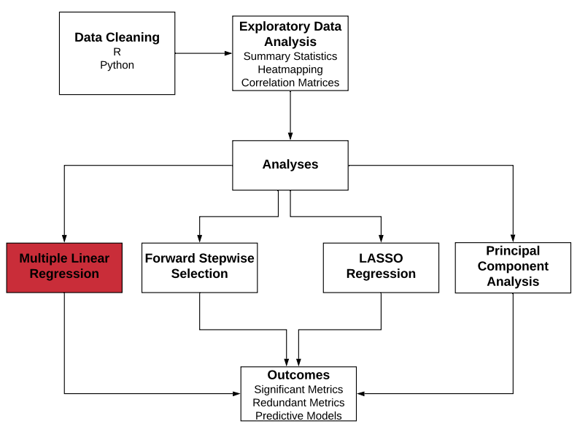
Quantitative Methods

Slide 30

Multiple Linear Regression
PMPM Cost | ED Score | RDM Score
Avoidance of Antibiotic treatment in Adults With Acute Bronchitis (-) | Medication Management for People With Asthma (+) | Medication Adherence for Cholesterol (Statins) (+)
Use of Imaging Studies for Low Back Pain (LBP) (-) | Annual EKGs or Cardiac Screening (+) | All-Cause Readmissions (-)
Annual EKGs or Cardiac Screening(-) | Colorectal Cancer Screening (+)
Adult BMI Assessment (+) | Comprehensive Diabetes Care: Eye Exam (retinal) performed (+)
Medication Adherence for Cholesterol (Statins) (+) | Use of Opioids from Multiple Providers (-)
Notes:
Low back pain as an example, statins as a counter example. Annual EKG screening did reduce ED score. Longer time to reflect cost outcomes. Talk about the metrics: Annual EKG screening and medication adherence (PMPM cost goes up and RDM goes down) made sense. All the significant ones are the STARS ratings.
Opioids should be orange and highlighted in presentation
Explain why cost should be lower and score should be higher

Slide 31
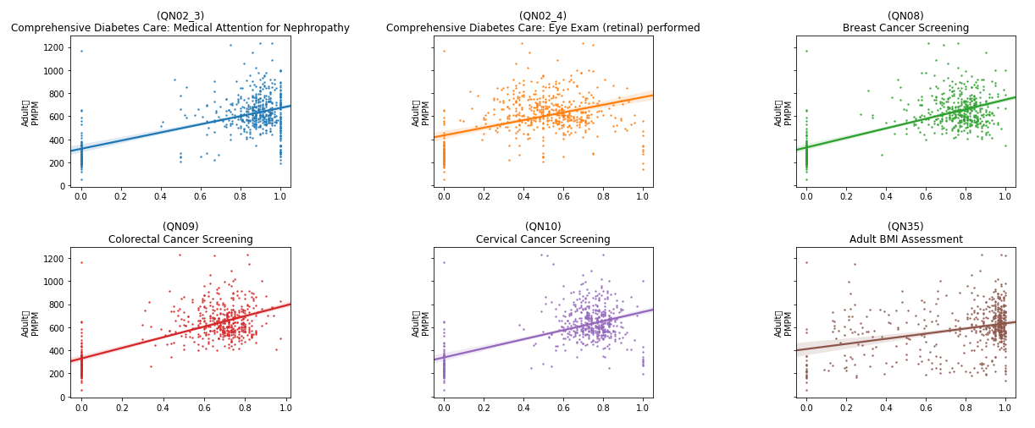
Lack of Clear Trends
Adult
PMPM
Adult
PMPM
Adult
PMPM
Adult
PMPM
Adult
PMPM
Adult
PMPM
Rate
Rate
Rate

Slide 32
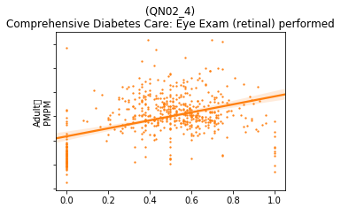
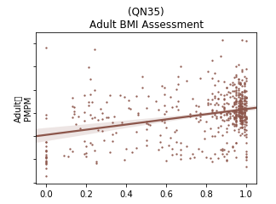
Lack of Clear Trends
Adult
PMPM
Adult
PMPM
High variability
Low confidence
Notes:
Continued data collection will make results of the program more clear/ accurate. If we had a control group would have made our life easier. There might not be linear trends but there could be clustering (control vs treatment)

Slide 33
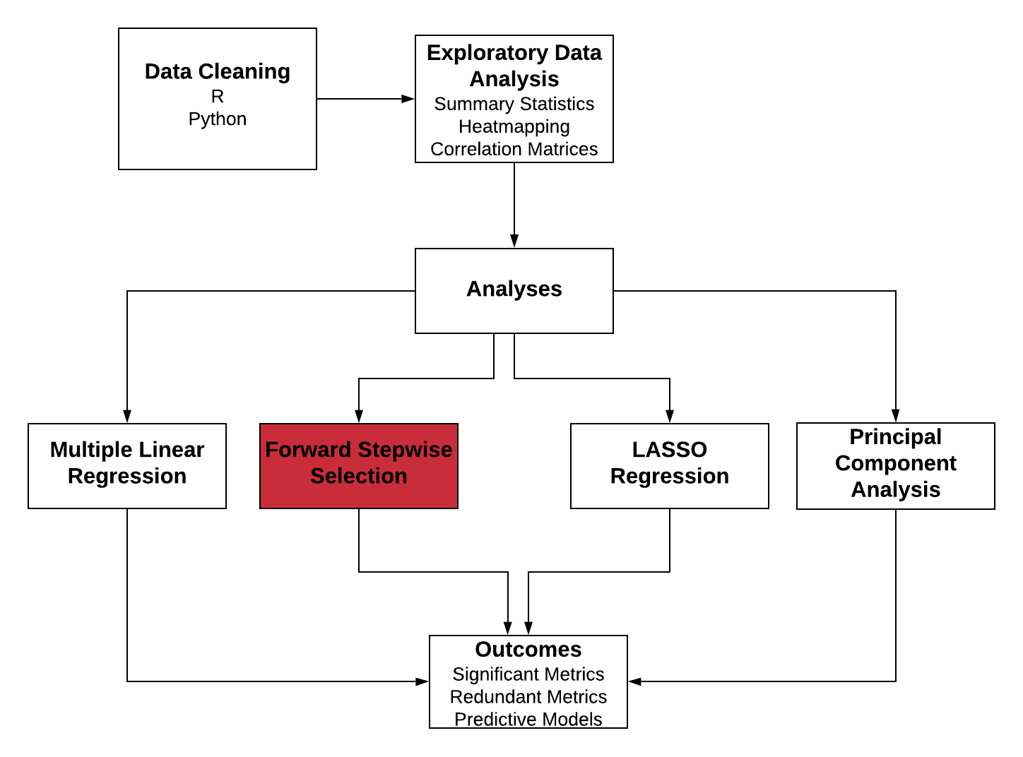
Quantitative Methods

Slide 34
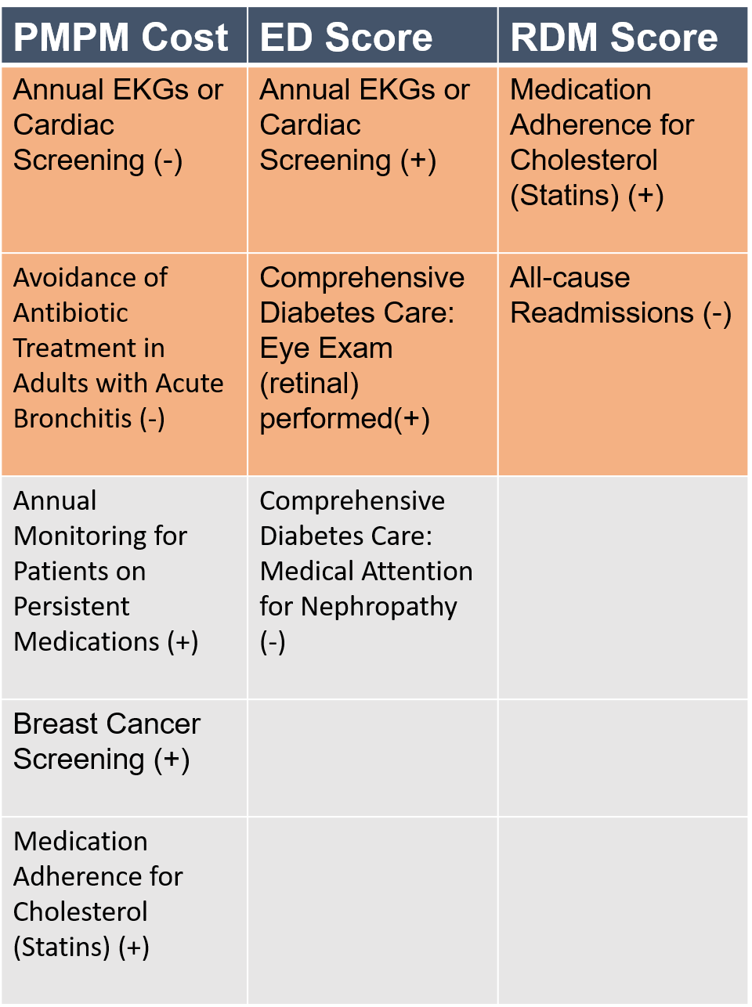
Forward Stepwise Selection
Expected/ Explainable Results
Notes:
Medication adherence should not be orange, correlation matrix (just with breast cancer screening collinearities)
Ekg and eye exam in ED score should be orange
Breast cancer screening highly collinear with almost everything
Potential metrics to look out for

Slide 35
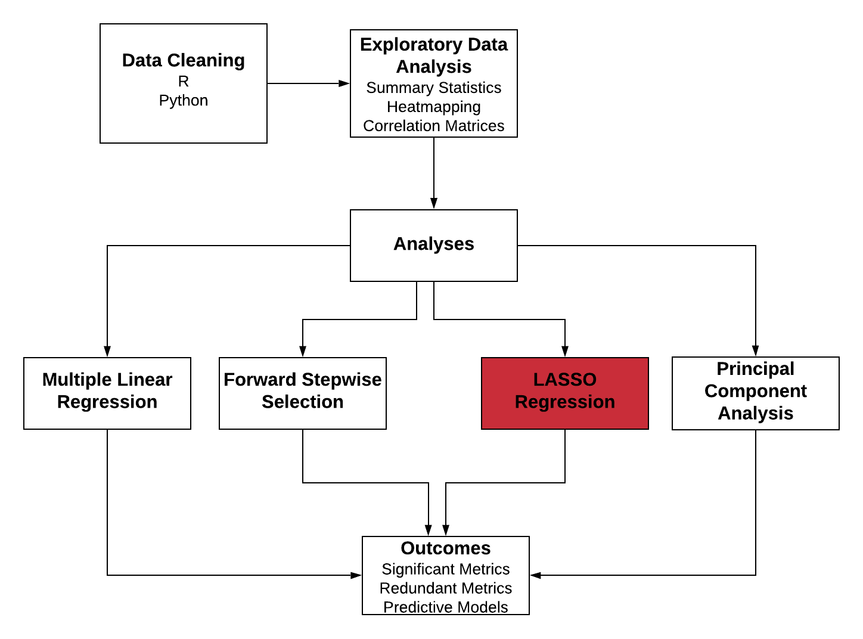
Quantitative Methods

Slide 36
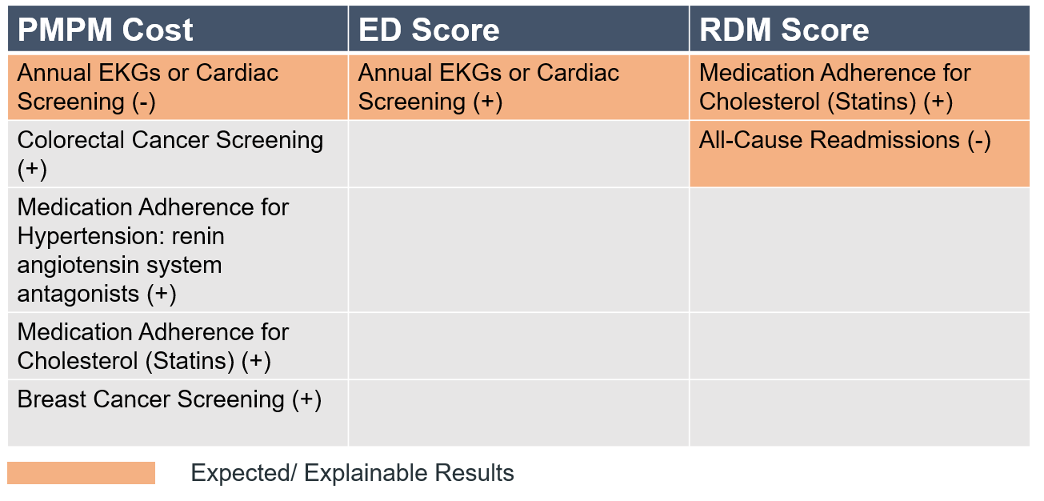
Lasso Regression
Investment in screening may yield a long-term return notwithstanding short-term cost increases
Notes:
The quality metrics increase the PMPM cost in short term but probably drive down costs long term.
Cardiac issues are short term diseases and hence they might affect the cost sooner than breast or colorectal screening.

Slide 37
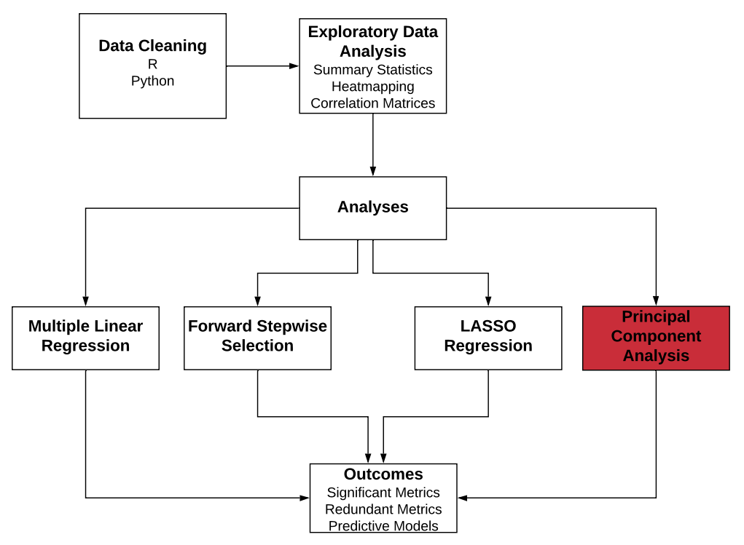
Quantitative Methods

Slide 38
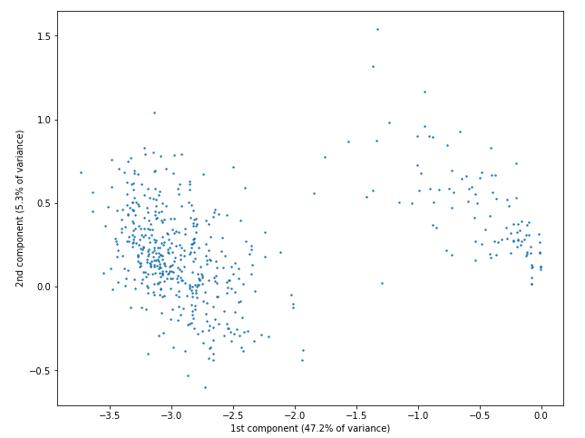
Principal Component Analysis (PCA)
Top contributors to the first component, which explains 50.94% of the variance in the adult data:
QN09 - Colorectal Cancer Screening
QN08 - Breast Cancer Screening
QN41 - Drug Therapy for Rheumatoid Arthritis
QN40 - Medication Adherence for Cholesterol (Statins)
QN39 - Medication Adherence for Hypertension: RASA
Top contributors to the second component, which explains 5.35% of the variance in the adult data:
QN76 - Controlling High Blood Pressure
QN55 - Annual Monitoring for Patients on Persistent Medications
QN35 - Adult BMI Assessment

Slide 39
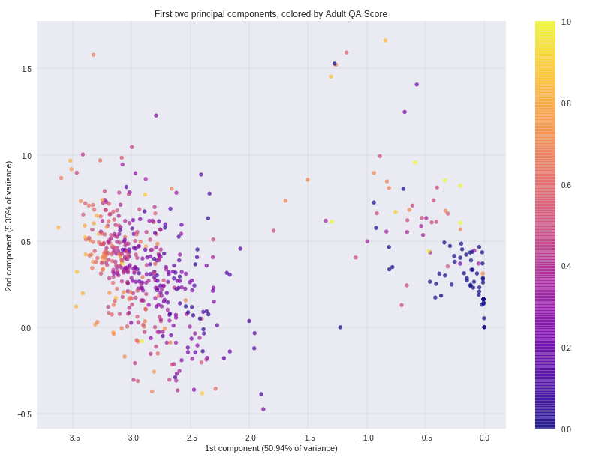
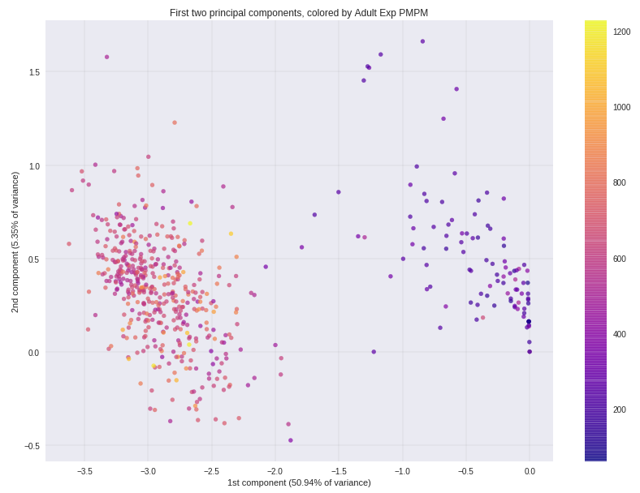
PCA - Clusters of Similar Providers
QA Score
PMPM Cost

Slide 40
Next Steps with Data
Collect data over time to enable time series analyses
Follow providers who are not participating in the program in order to study counterfactual
Focus on metrics that are highly colinear to identify potential candidates for removal
Diversify metrics across CMS-recommended “meaningful measures” areas of focus

Slide 41
Program Evaluation Framework
Needs Assessment
Program Theory
Process Evaluation
Outcome Evaluation

Slide 42
Takeaways
VBR is early in the Continuous Improvement Cycle
More closely aligned measurement
Majority of progress has been made in cost measurement
Complexity of the program inhibits physician engagement
Missing a consistent, repeatable evaluation method

Slide 43
Recommendations
Quality Metrics
Collect more data over time to enable better time-series analysis
Eliminate highly correlated metrics, they add no value & this would reduce physician fatigue
Program-Specific
Work with providers to ensure that physicians are translating feedback into process and behavioral changes
Structure incentives to elicit desirable changes
Evaluation of the Program
Measure outcomes related to health and patient experience
Assess the causal effect of the program using a control group
Gather patient-level data in order to understand how the program is affecting patients, not just providers and payor

Slide 44
Questions?

Slide 45
References
United Healthcare Report - https://www.uhc.com/content/dam/uhcdotcom/en/ValueBasedCare/PDFs/VBC-Nov2016-Online-Report.pdf
Miller, H. (2017) Why Value Based Purchasing Isn’t Working and How to Fix it
Peter Rossi, Mark Lipsey, Gary Henry. Evaluation – A Systematic Approach. 8th Edition.
Eijkenaar, Frank, Martin Emmert, Manfred Scheppach, and Oliver Schöffski. "Effects of pay for performance in health care: a systematic review of systematic reviews." Health policy 110, no. 2-3 (2013): 115-130.
Damberg CL, Sorbero ME, Lovejoy SL, et al. Measuring Success in Health Care Value-Based Purchasing Programs: Findings from an Environmental Scan, Literature Review, and Expert Panel Discussions. Rand Health Q 2014;4:9
CMS Meaningful Measures guide - https://www.cms.gov/Medicare/Quality-Initiatives-Patient-Assessment-Instruments/QualityInitiativesGenInfo/MMF/General-info-Sub-Page

Slide 46
Appendix

Slide 47
Program Evaluation Framework
Context for Evaluation (Stage 0)
What is the purpose of the evaluation?
Formative evaluation (primary purpose is to analyze the program to improve and strengthen it). To some extent outcome evaluation.
Since the True performance program has been implemented only for about 2 years now, we cannot really say for sure if it has achieved its outcome or not.
The main purpose of the evaluation is to evaluate the cost outcomes (impact evaluation)
Who are the stakeholders involved?
Highmark Inc Data Science team
Highmark Inc Value Based Reimbursement team
Highmark Inc Providers in their network (PCPs)
Patients
What are the limitations and constraints of this evaluation?
Limitations: Lack of comprehensive time-series data, lack of a mechanism to collect health outcomes and patient experience outcomes.
Constraints: Time duration for evaluation
Needs Assessment (Stage 1) ( will focus on the issue of over utilization and low quality)
What is the problem that the program is trying to address?
Misalignment of incentives between payer, provider, patients
Healthcare incentives not aligned with healthcare value
Issues with primary care within the United States
What is the extent of the problem?
Increased amount of spending on healthcare is not reflecting in the health or quality outcomes
Add details about the numbers related to healthcare spending and outcomes compared to other countries
Who or what is the target population?
Physicians, patients (to a lesser extent)
Program Theory (Stage 2) ( structure of the program, research on other VBR programs)
What is the True Performance Program? (create a logic model)
How are the outcomes measured? (impact theory)
How were the quality metrics in the program selected?
How should the quality metrics be measured?
How does the program engage providers/ physicians in improving their quality scores?
Do the measurement of quality metrics improve the outcomes? (In theory)
Process Evaluation (Stage 3) (qualitative analysis of interviews with physicians)
Are participants satisfied with the program? (Satisfaction)
How many providers/ persons are part of the program? (Reach)
Extent to which the program was implemented consistently with underlying theory/ design/ philosophy. (fidelity of program)
Extent to which participants actively engage with program (dose received)
Amount of each component delivered/ details about quality metrics? (dose delivered)
Outcome Evaluation (Stage 4) (data analysis of the quality metrics)
Define the counterfactual (outcomes in the absence of the program)
What could be the potential confounders/selection bias?
Program effects (Quantitative results)
Difference in outcomes between regions, patient groups, providers
Which measures contribute most to the cost outcome?
Recommendations (Stage 5)
Spending + quality + infrastructure support
Increase the share of provider reimbursements tied to VBR to incentivize organizational changes
Build stronger payer + provider relationships
Align measures across different payer contracts (to reduce the burden of data collection)
Better align individual physician incentives with VBR contract incentives

Slide 48
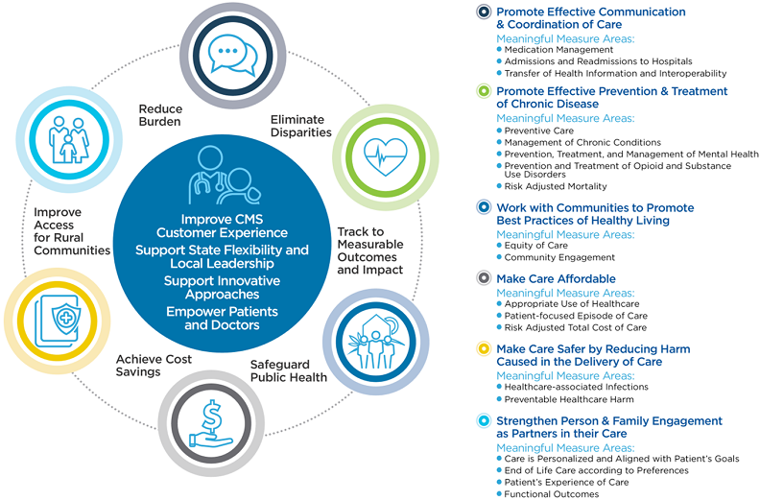
CMS Meaningful Measurement Areas
Source: https://www.cms.gov/Medicare/Quality-Initiatives-Patient-Assessment-Instruments/QualityInitiativesGenInfo/MMF/General-info-Sub-Page

Slide 49
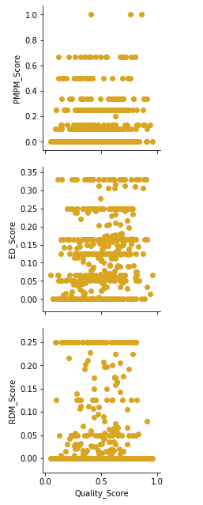
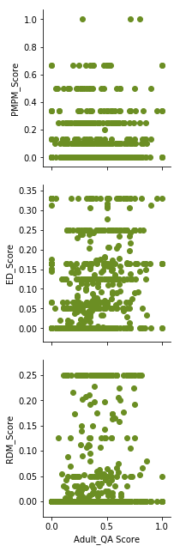
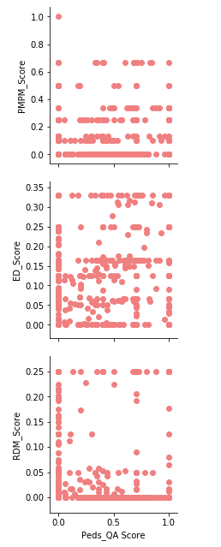
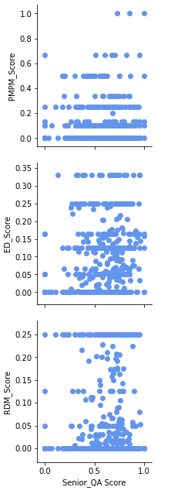
Quality vs Outcomes

Slide 50
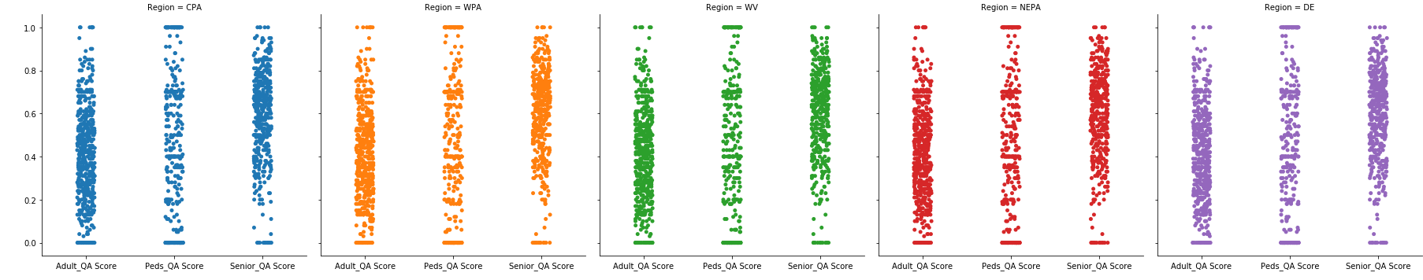
QA Score per Region – by pop

Slide 51
QA Score per Region

Slide 52
PMPM Score per Region

Slide 53
T-test Results by Region (α = 0.05)
PMPM Score
PA regions had lower scores than all other regions
WPA had higher scores than NEPA
QA Score
PA had a much higher score than all other regions
WPA greatly outperformed NEPA and WV

Slide 54
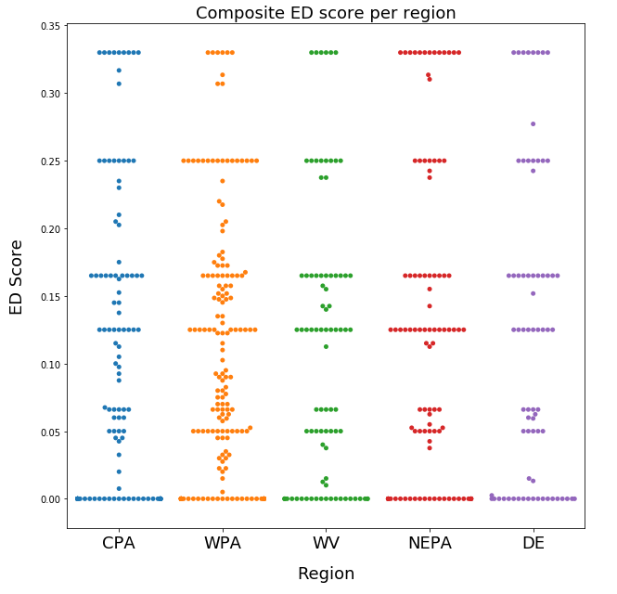
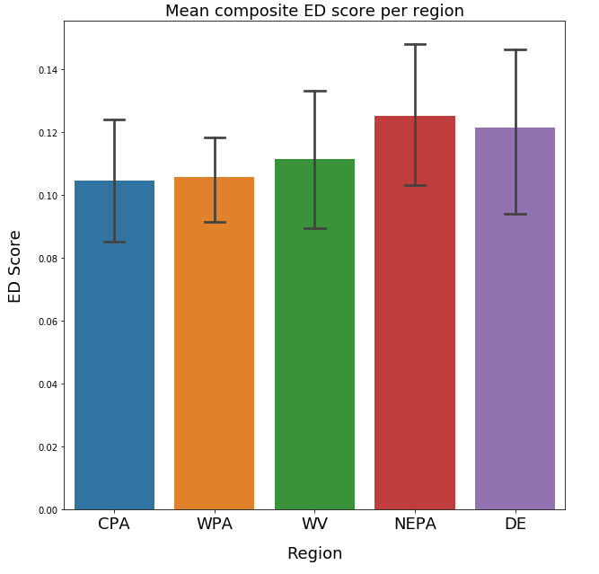
ED Score per Region

Slide 55
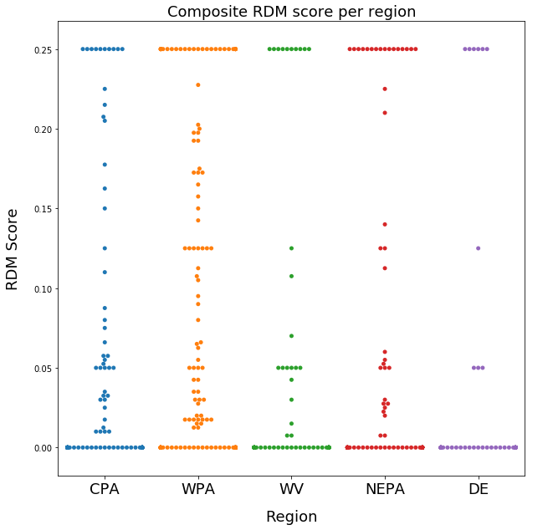
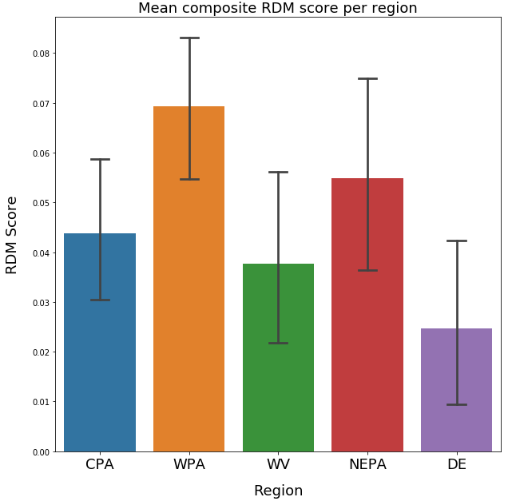
RDM Score per Region

Slide 56
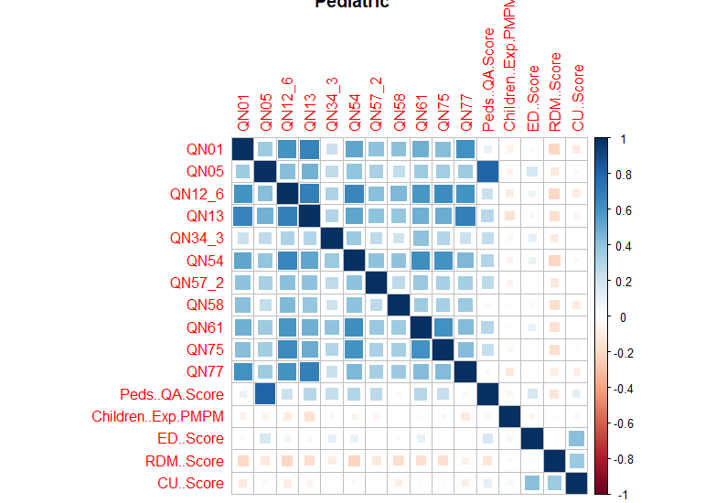
Pediatric Correlation
Notes:
The quality metrics increase the PMPM cost in short term but probably drive down costs long term.
Cardiac issues are short term diseases and hence they might affect the cost sooner than breast or colorectal screening.

Slide 57
Adult Correlation
Notes:
The quality metrics increase the PMPM cost in short term but probably drive down costs long term.
Cardiac issues are short term diseases and hence they might affect the cost sooner than breast or colorectal screening.

Slide 58
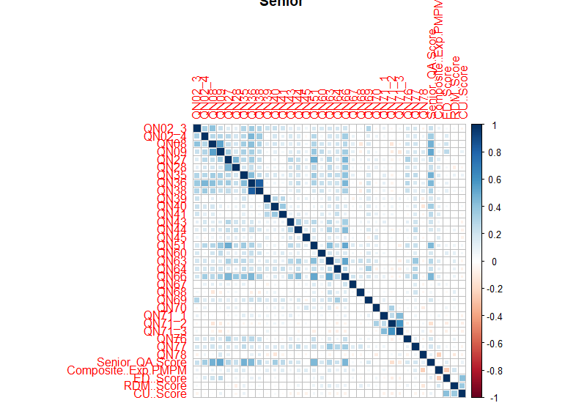
Senior Correlation
Notes:
The quality metrics increase the PMPM cost in short term but probably drive down costs long term.
Cardiac issues are short term diseases and hence they might affect the cost sooner than breast or colorectal screening.

Slide 59
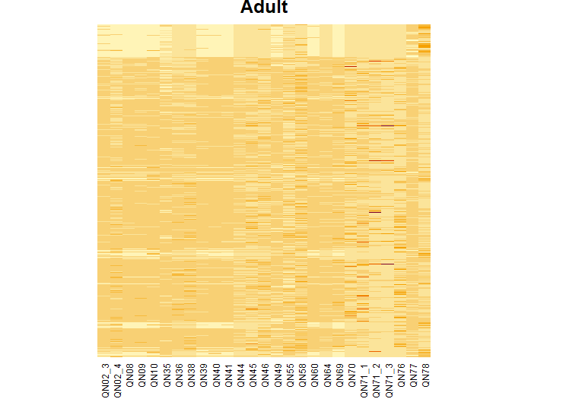
Adult Heatmap
Notes:
Medication adherence should not be orange, correlation matrix (just with breast cancer screening collinearities)
Ekg and eye exam in ED score should be orange
Breast cancer screening highly collinear with almost everything
Potential metrics to look out for

Slide 60
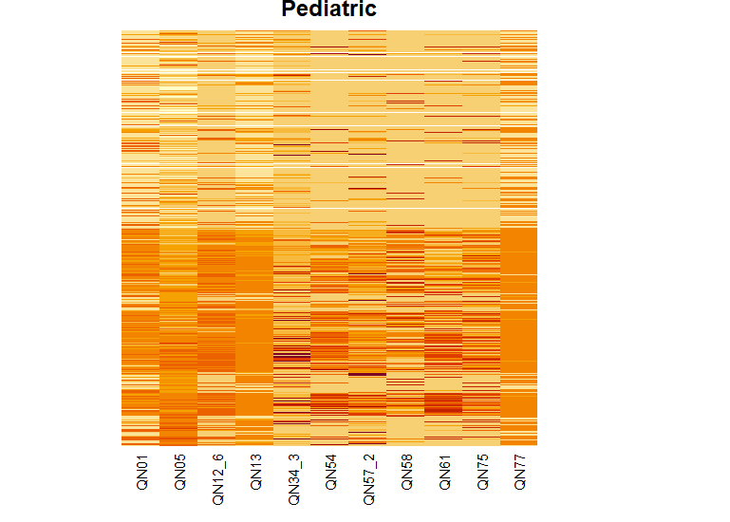
Pediatric Heatmap
Notes:
Medication adherence should not be orange, correlation matrix (just with breast cancer screening collinearities)
Ekg and eye exam in ED score should be orange
Breast cancer screening highly collinear with almost everything
Potential metrics to look out for

Slide 61
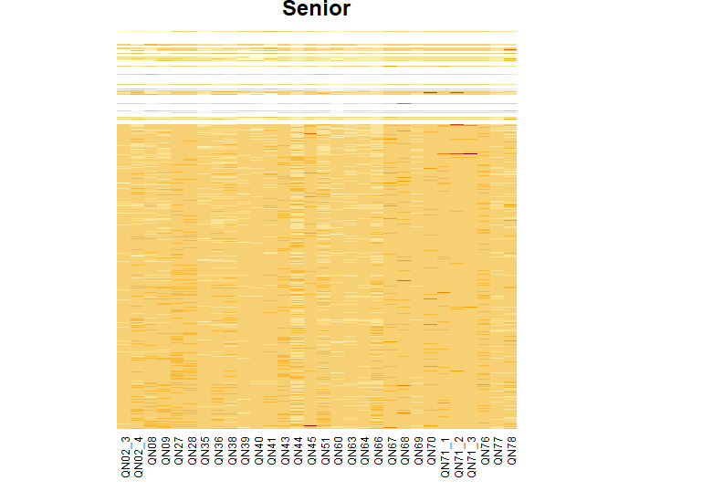
Senior Heatmap
Notes:
Medication adherence should not be orange, correlation matrix (just with breast cancer screening collinearities)
Ekg and eye exam in ED score should be orange
Breast cancer screening highly collinear with almost everything
Potential metrics to look out for

Slide 62
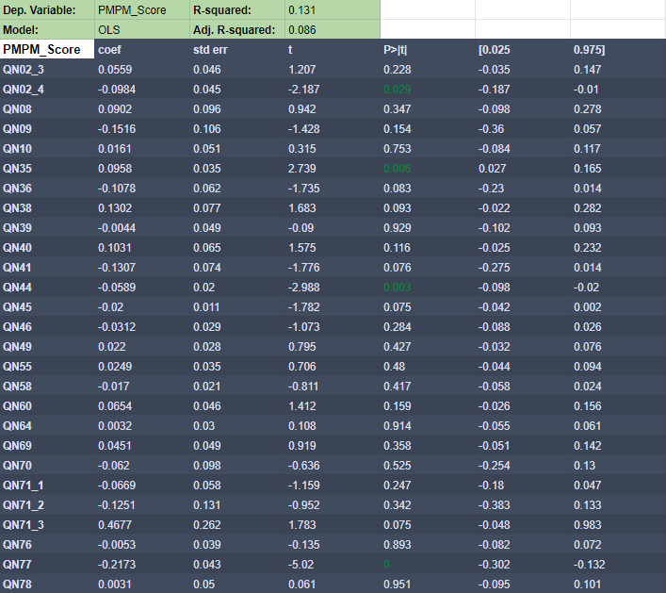
Notes:
ML Regression

Slide 63
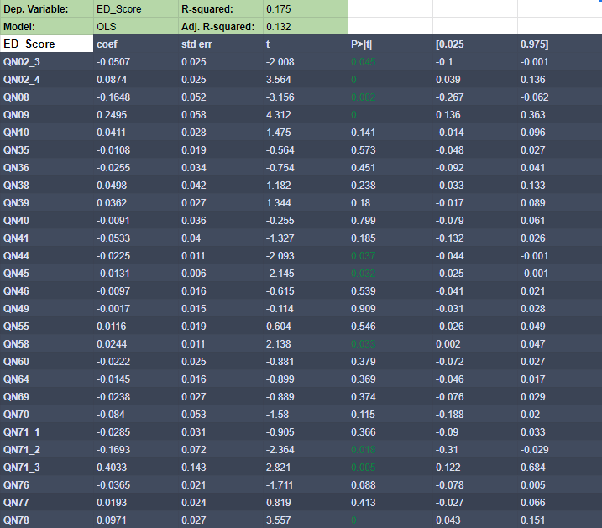
Notes:
ML Regression

Slide 64
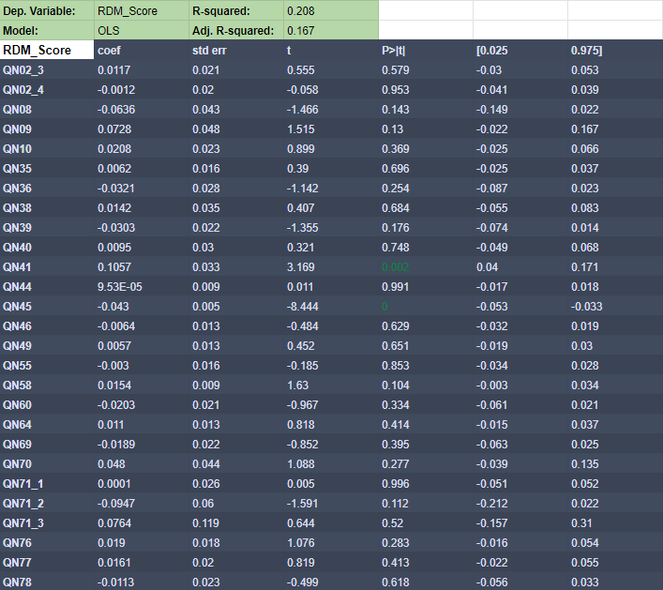
Notes:
ML Regression

Slide 65
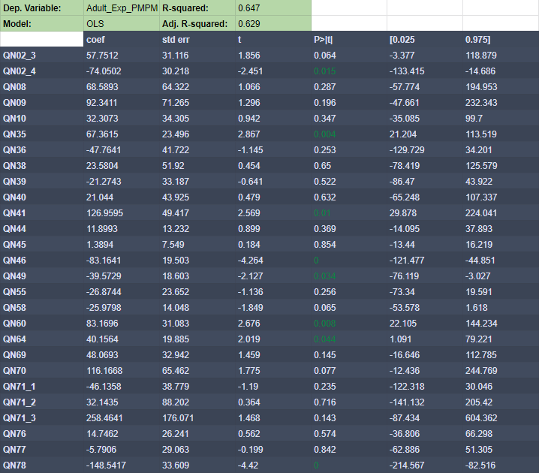
Notes:
ML Regression

Slide 66
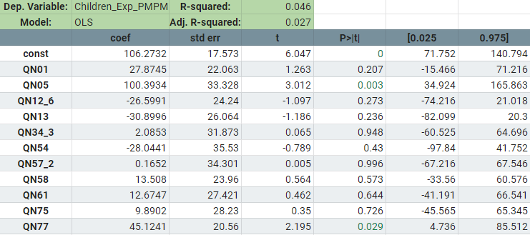

Slide 67
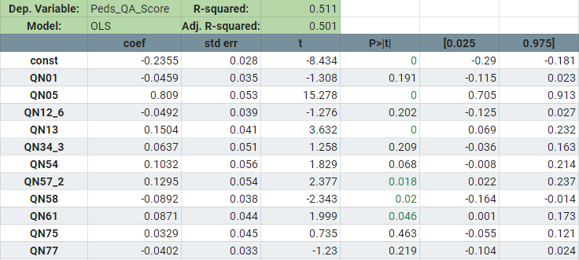

Slide 68
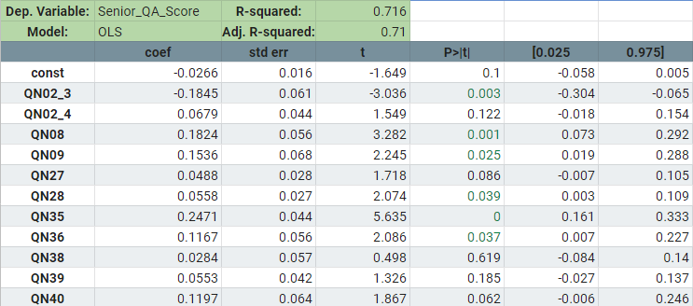

Slide 69
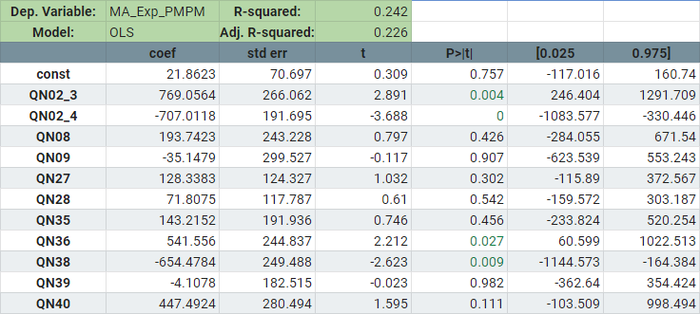

Slide 70
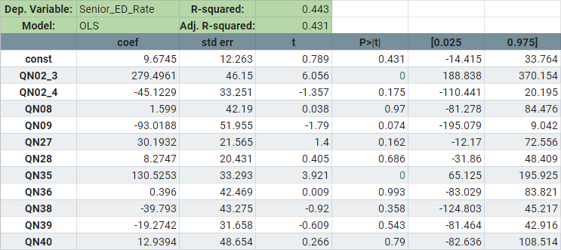

Slide 71
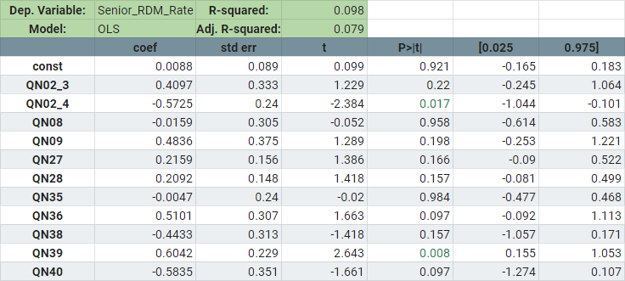

Slide 72
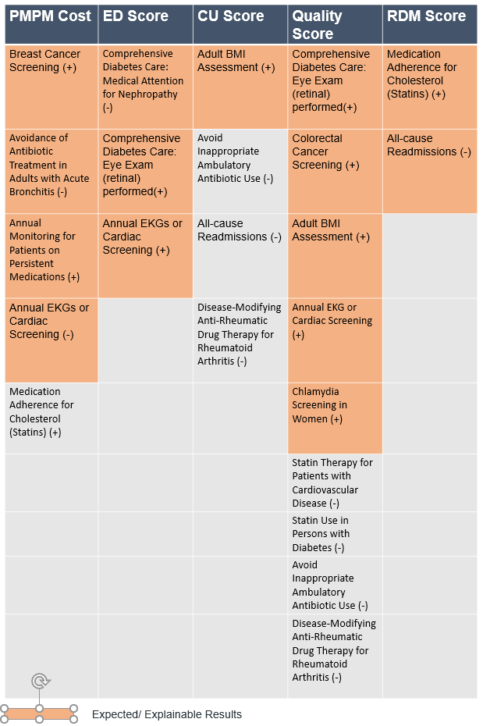
Forward Stepwise Selection
Notes:
Medication adherence should not be orange, correlation matrix (just with breast cancer screening collinearities)
Ekg and eye exam in ED score should be orange
Breast cancer screening highly collinear with almost everything
Potential metrics to look out for

Slide 73
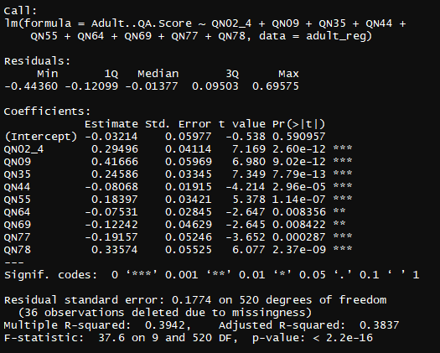
Adult QA Forward Stepwise
Notes:
Medication adherence should not be orange, correlation matrix (just with breast cancer screening collinearities)
Ekg and eye exam in ED score should be orange
Breast cancer screening highly collinear with almost everything
Potential metrics to look out for

Slide 74
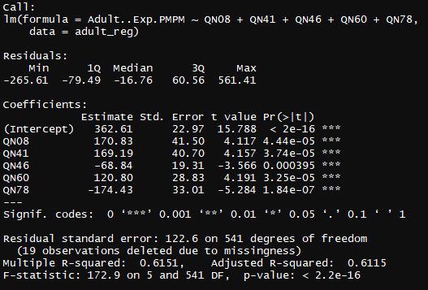
Adult PMPM Forward Stepwise
Notes:
Medication adherence should not be orange, correlation matrix (just with breast cancer screening collinearities)
Ekg and eye exam in ED score should be orange
Breast cancer screening highly collinear with almost everything
Potential metrics to look out for

Slide 75

Adult ED Forward Stepwise
Notes:
Medication adherence should not be orange, correlation matrix (just with breast cancer screening collinearities)
Ekg and eye exam in ED score should be orange
Breast cancer screening highly collinear with almost everything
Potential metrics to look out for

Slide 76

Adult RDM Forward Stepwise
Notes:
Medication adherence should not be orange, correlation matrix (just with breast cancer screening collinearities)
Ekg and eye exam in ED score should be orange
Breast cancer screening highly collinear with almost everything
Potential metrics to look out for

Slide 77

Adult CU Forward Stepwise
Notes:
Medication adherence should not be orange, correlation matrix (just with breast cancer screening collinearities)
Ekg and eye exam in ED score should be orange
Breast cancer screening highly collinear with almost everything
Potential metrics to look out for

Slide 78

Senior QA Forward Stepwise
Notes:
Medication adherence should not be orange, correlation matrix (just with breast cancer screening collinearities)
Ekg and eye exam in ED score should be orange
Breast cancer screening highly collinear with almost everything
Potential metrics to look out for

Slide 79

Senior PMPM Forward Stepwise
Notes:
Medication adherence should not be orange, correlation matrix (just with breast cancer screening collinearities)
Ekg and eye exam in ED score should be orange
Breast cancer screening highly collinear with almost everything
Potential metrics to look out for

Slide 80

Senior ED Forward Stepwise
Notes:
Medication adherence should not be orange, correlation matrix (just with breast cancer screening collinearities)
Ekg and eye exam in ED score should be orange
Breast cancer screening highly collinear with almost everything
Potential metrics to look out for

Slide 81

Senior RDM Forward Stepwise
Notes:
Medication adherence should not be orange, correlation matrix (just with breast cancer screening collinearities)
Ekg and eye exam in ED score should be orange
Breast cancer screening highly collinear with almost everything
Potential metrics to look out for

Slide 82

Senior CU Forward Stepwise
Notes:
Medication adherence should not be orange, correlation matrix (just with breast cancer screening collinearities)
Ekg and eye exam in ED score should be orange
Breast cancer screening highly collinear with almost everything
Potential metrics to look out for

Slide 83

Pediatric QA Forward Stepwise
Notes:
Medication adherence should not be orange, correlation matrix (just with breast cancer screening collinearities)
Ekg and eye exam in ED score should be orange
Breast cancer screening highly collinear with almost everything
Potential metrics to look out for

Slide 84

Pediatric PMPM Forward Stepwise
Notes:
Medication adherence should not be orange, correlation matrix (just with breast cancer screening collinearities)
Ekg and eye exam in ED score should be orange
Breast cancer screening highly collinear with almost everything
Potential metrics to look out for

Slide 85

Pediatric ED Forward Stepwise
Notes:
Medication adherence should not be orange, correlation matrix (just with breast cancer screening collinearities)
Ekg and eye exam in ED score should be orange
Breast cancer screening highly collinear with almost everything
Potential metrics to look out for

Slide 86

Pediatric RDM Forward Stepwise
Notes:
Medication adherence should not be orange, correlation matrix (just with breast cancer screening collinearities)
Ekg and eye exam in ED score should be orange
Breast cancer screening highly collinear with almost everything
Potential metrics to look out for

Slide 87

Pediatric CU Forward Stepwise
Notes:
Medication adherence should not be orange, correlation matrix (just with breast cancer screening collinearities)
Ekg and eye exam in ED score should be orange
Breast cancer screening highly collinear with almost everything
Potential metrics to look out for

Slide 88

Adult PMPM LASSO
Notes:
Medication adherence should not be orange, correlation matrix (just with breast cancer screening collinearities)
Ekg and eye exam in ED score should be orange
Breast cancer screening highly collinear with almost everything
Potential metrics to look out for

Slide 89

Adult ED LASSO
Notes:
Medication adherence should not be orange, correlation matrix (just with breast cancer screening collinearities)
Ekg and eye exam in ED score should be orange
Breast cancer screening highly collinear with almost everything
Potential metrics to look out for

Slide 90

Adult RDM LASSO
Notes:
Medication adherence should not be orange, correlation matrix (just with breast cancer screening collinearities)
Ekg and eye exam in ED score should be orange
Breast cancer screening highly collinear with almost everything
Potential metrics to look out for

Slide 91

Adult QA LASSO
Notes:
Medication adherence should not be orange, correlation matrix (just with breast cancer screening collinearities)
Ekg and eye exam in ED score should be orange
Breast cancer screening highly collinear with almost everything
Potential metrics to look out for

Slide 92

Pediatric PMPM LASSO
Notes:
Medication adherence should not be orange, correlation matrix (just with breast cancer screening collinearities)
Ekg and eye exam in ED score should be orange
Breast cancer screening highly collinear with almost everything
Potential metrics to look out for

Slide 93

Senior QA LASSO
Notes:
Medication adherence should not be orange, correlation matrix (just with breast cancer screening collinearities)
Ekg and eye exam in ED score should be orange
Breast cancer screening highly collinear with almost everything
Potential metrics to look out for

Slide 94

Adult PMPM Representative LASSO Cross Vaidation
Notes:
Medication adherence should not be orange, correlation matrix (just with breast cancer screening collinearities)
Ekg and eye exam in ED score should be orange
Breast cancer screening highly collinear with almost everything
Potential metrics to look out for

Slide 95

Adult PMPM Representative LASSO L1 Plot
Notes:
Medication adherence should not be orange, correlation matrix (just with breast cancer screening collinearities)
Ekg and eye exam in ED score should be orange
Breast cancer screening highly collinear with almost everything
Potential metrics to look out for

Slide 96

PCA Results Adult

Slide 97

PCA Results Adult

Slide 98


Slide 99


Slide 100


Slide 101


Slide 102


Slide 103

PCA Results Ped

Slide 104

PCA Results Ped

Slide 105


Slide 106


Slide 107


Slide 108


Slide 109


Slide 110

PCA Results Senior

Slide 111

PCA Results Senior

Slide 112


Slide 113


Slide 114


Slide 115


Slide 116


